Slide 1
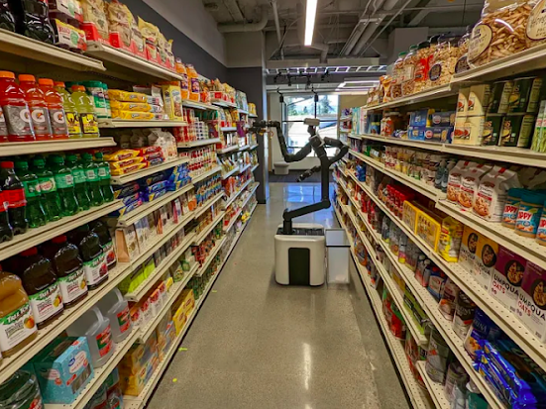
Self Service Autonomous Mobile Robot for Grocery Store
Presented By
Jitesh
Rishabh
Pratik
Jerin
Brinton

Slide 2
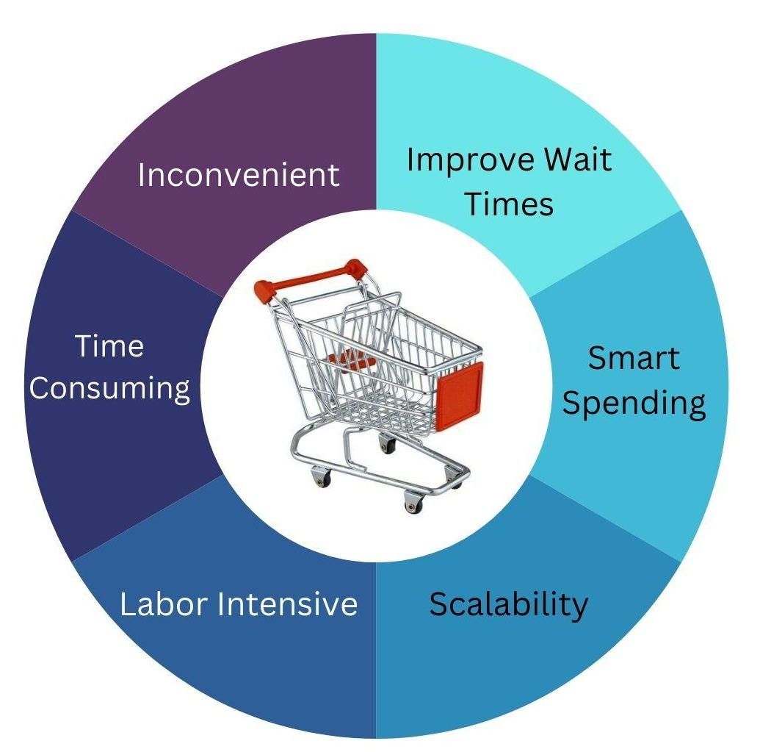
Problem Statement and Motivation

Slide 3
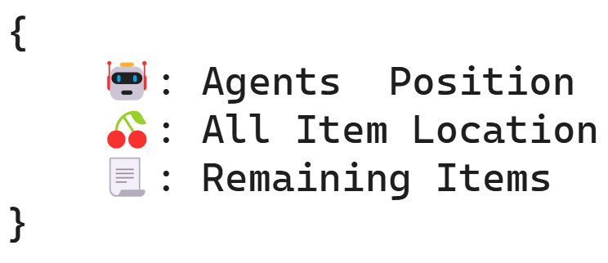
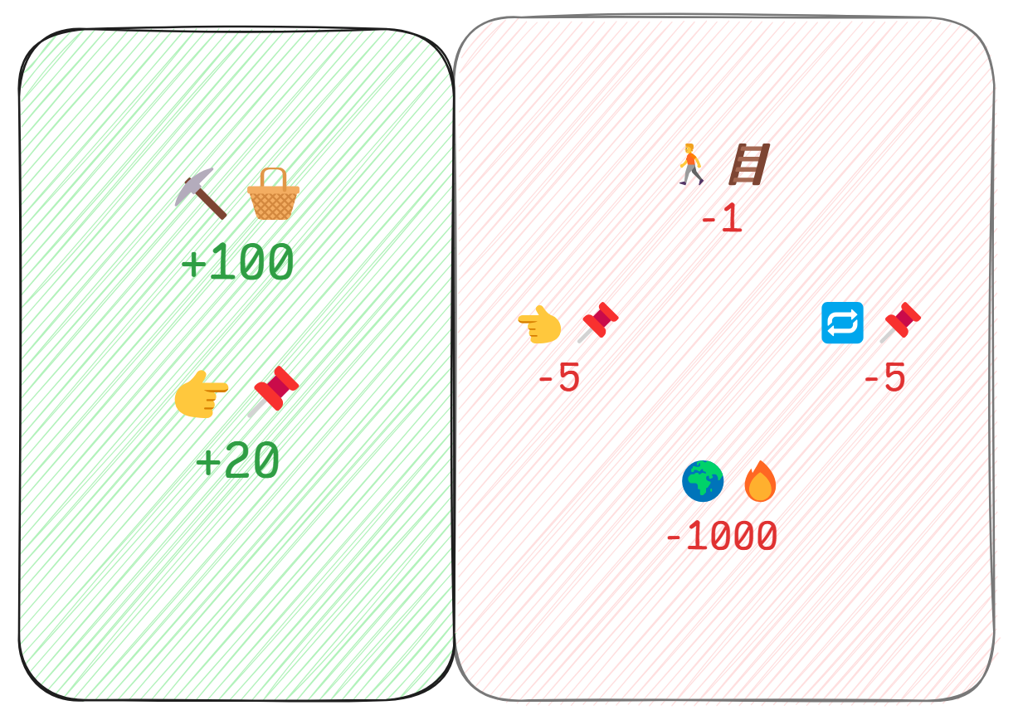

State, Action, Reward : 🏠
STATE
REWARDS
ACTION

Slide 4
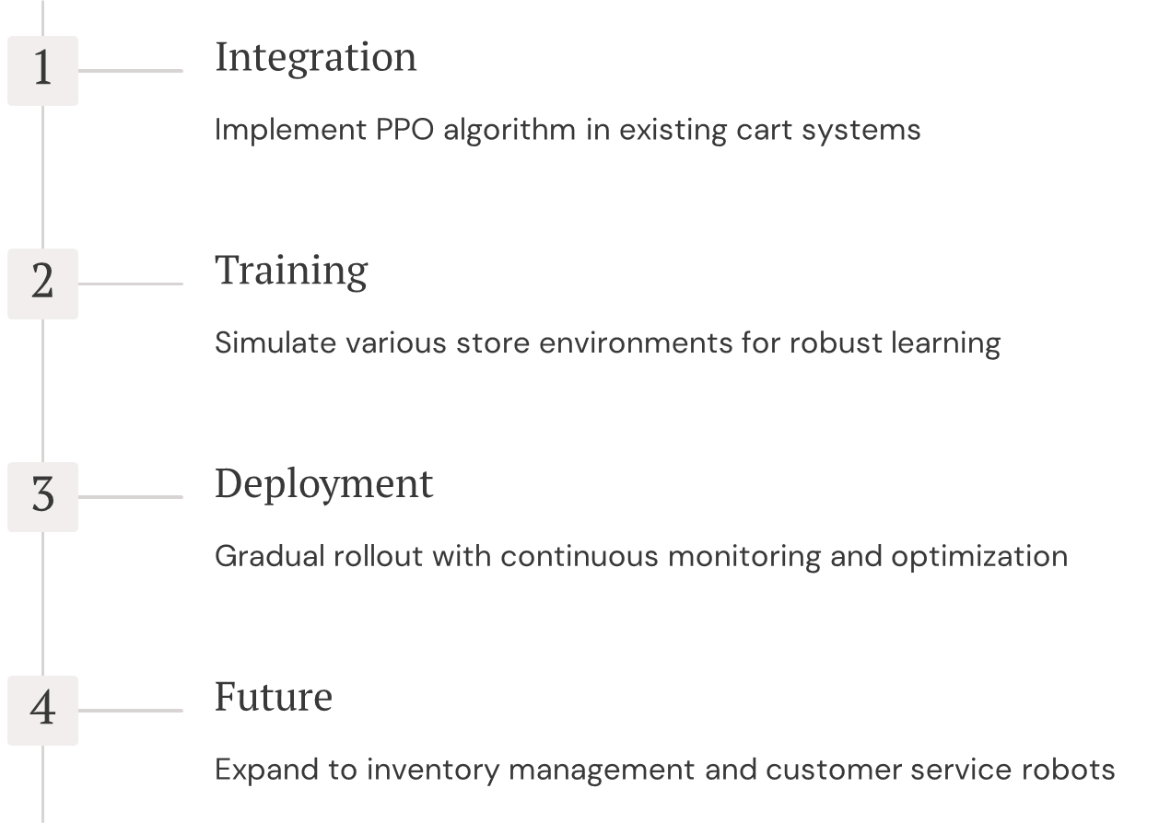
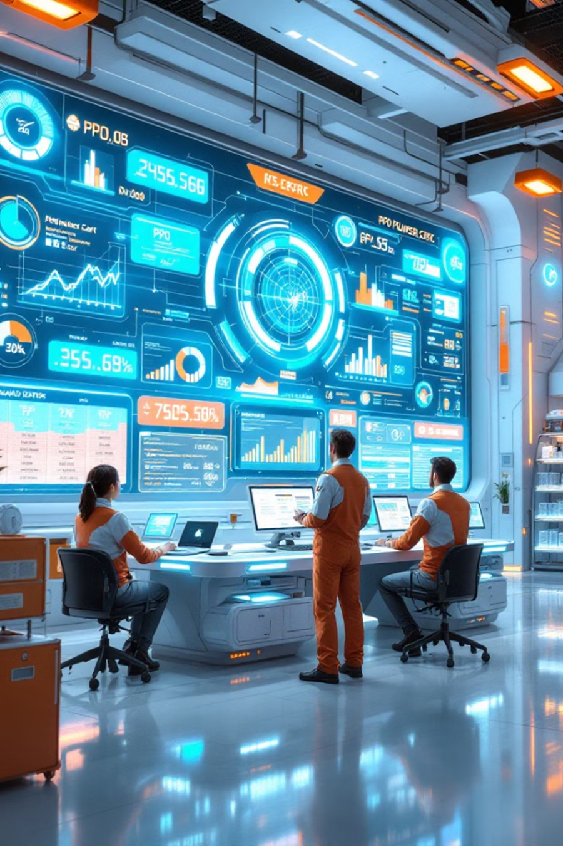
Introduction to PPO

Slide 5
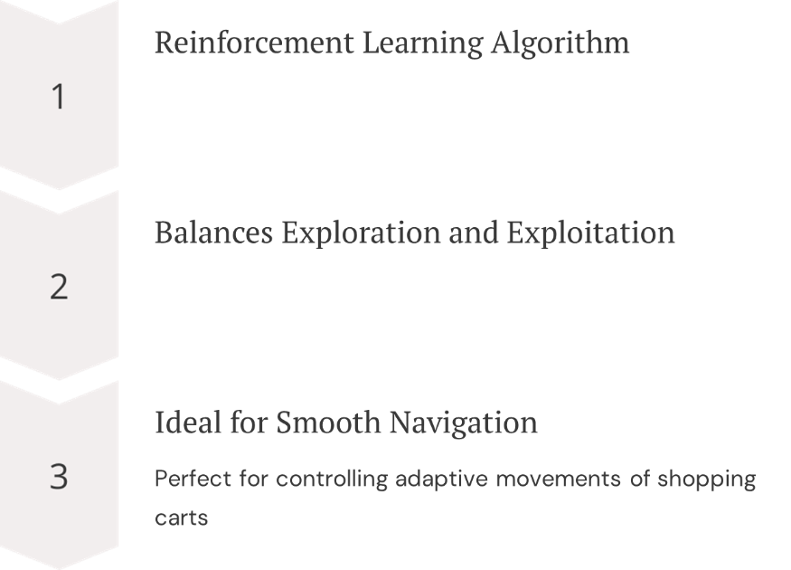
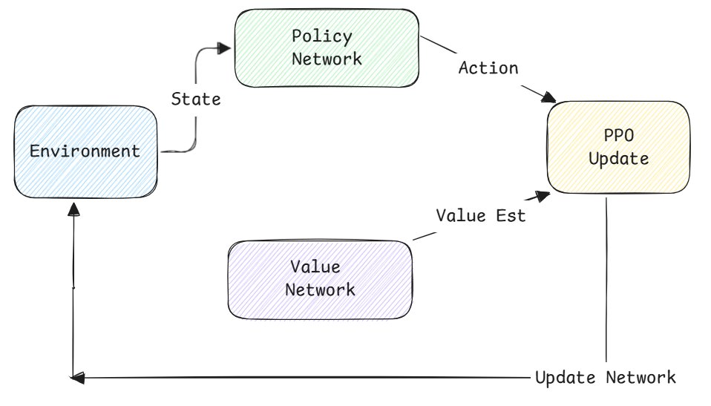
Implementing PPO in Retail

Slide 6
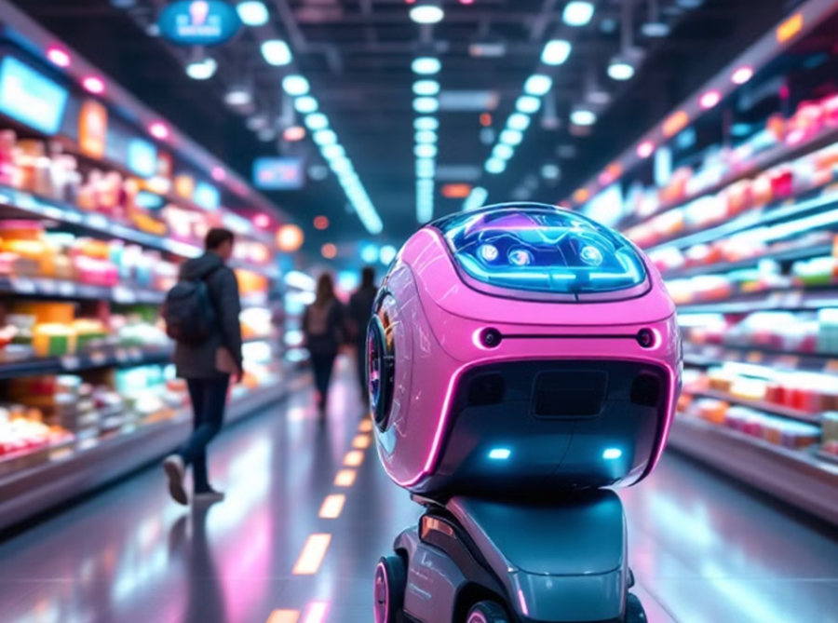
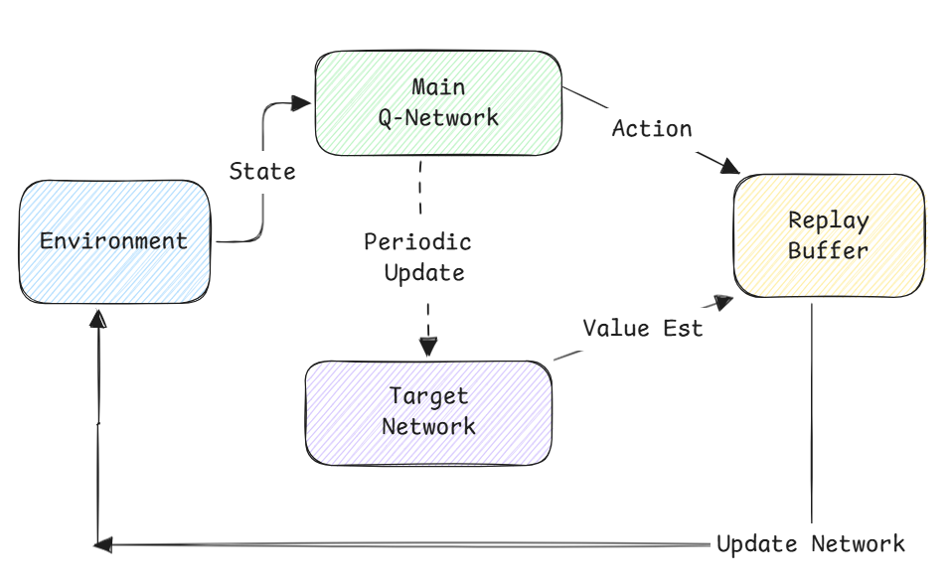
Introduction to DQN
What is DQN?
Reinforcement learning algorithm using neural networks
Ideal for discrete actions in dynamics environments
Applications
Enables efficient autonomous shopping cart operations
Adapt to changing store layouts and conditions

Slide 7
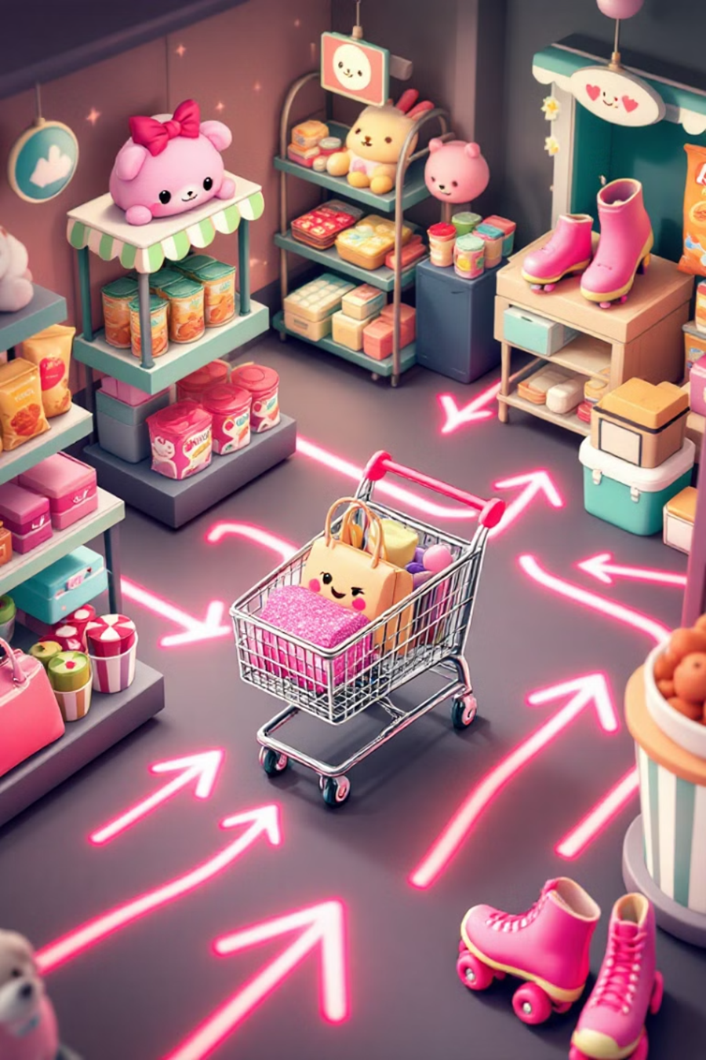







DQN Working
Inputs
Store layout, cart locations, item positions, obstacles
Processing
Neural Networks, analyzed data
Output
Move, turn, pick item, avoid obstacles
Learning
Reward for efficiency, penalties
Benefits of DQN
Efficiency
Adaptability
Scalability

Slide 8
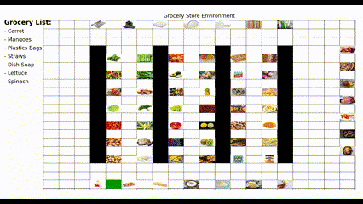
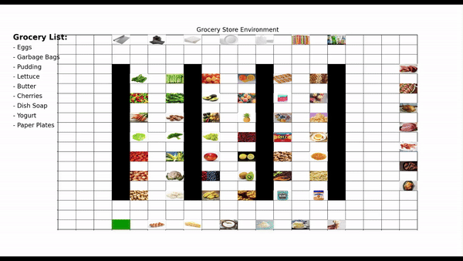
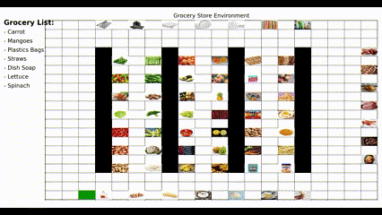
Output Visualization
PPO
DQN
A*

Slide 9
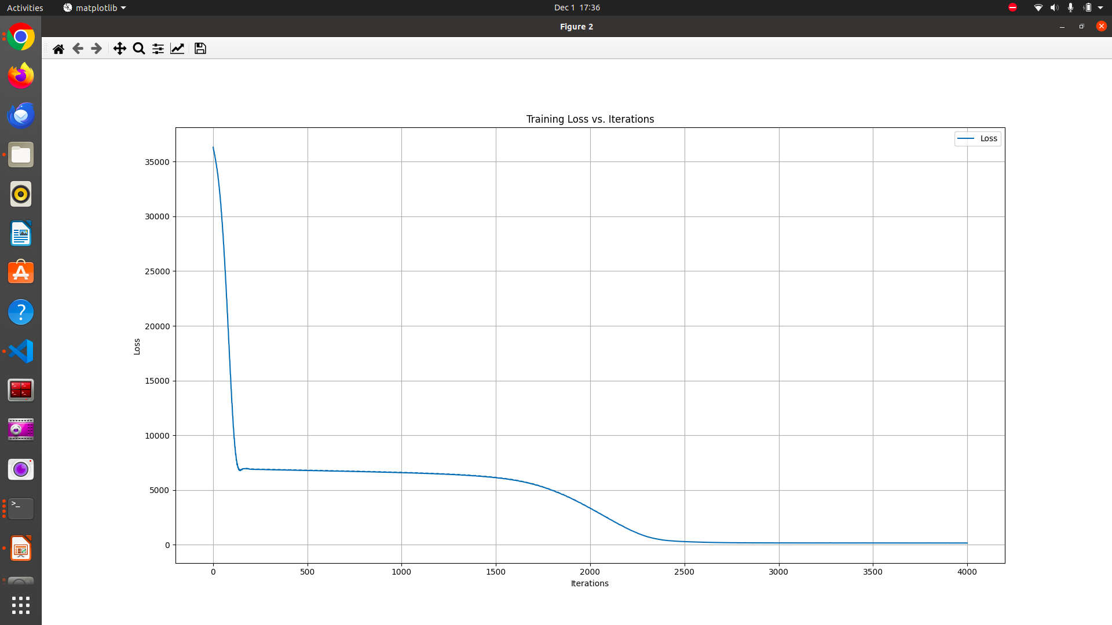
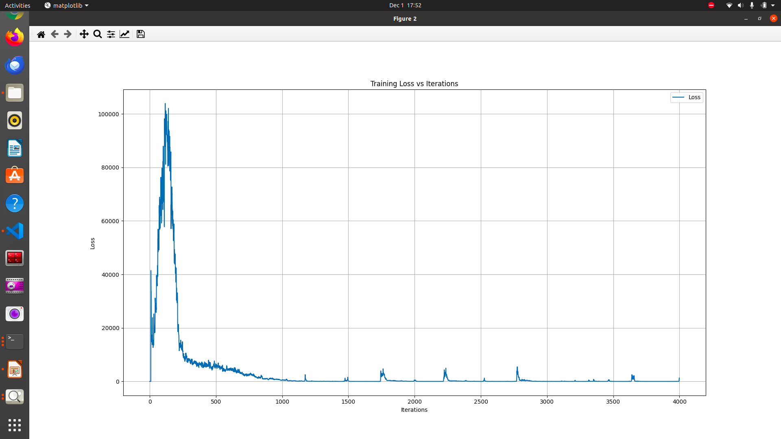
Loss vs Iteration Visualizations
PPO
DQN

Slide 10
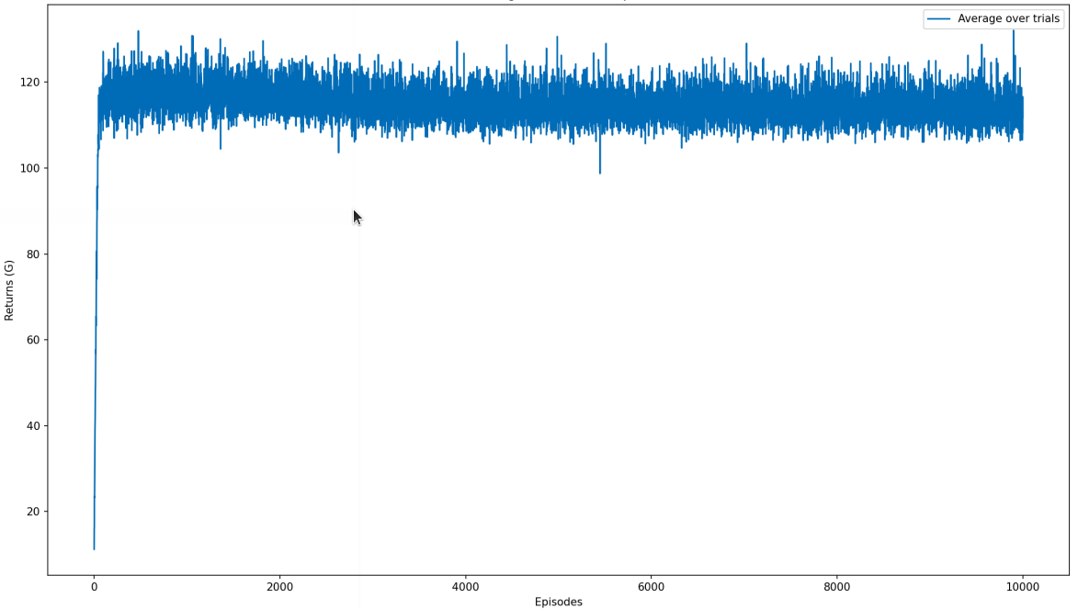
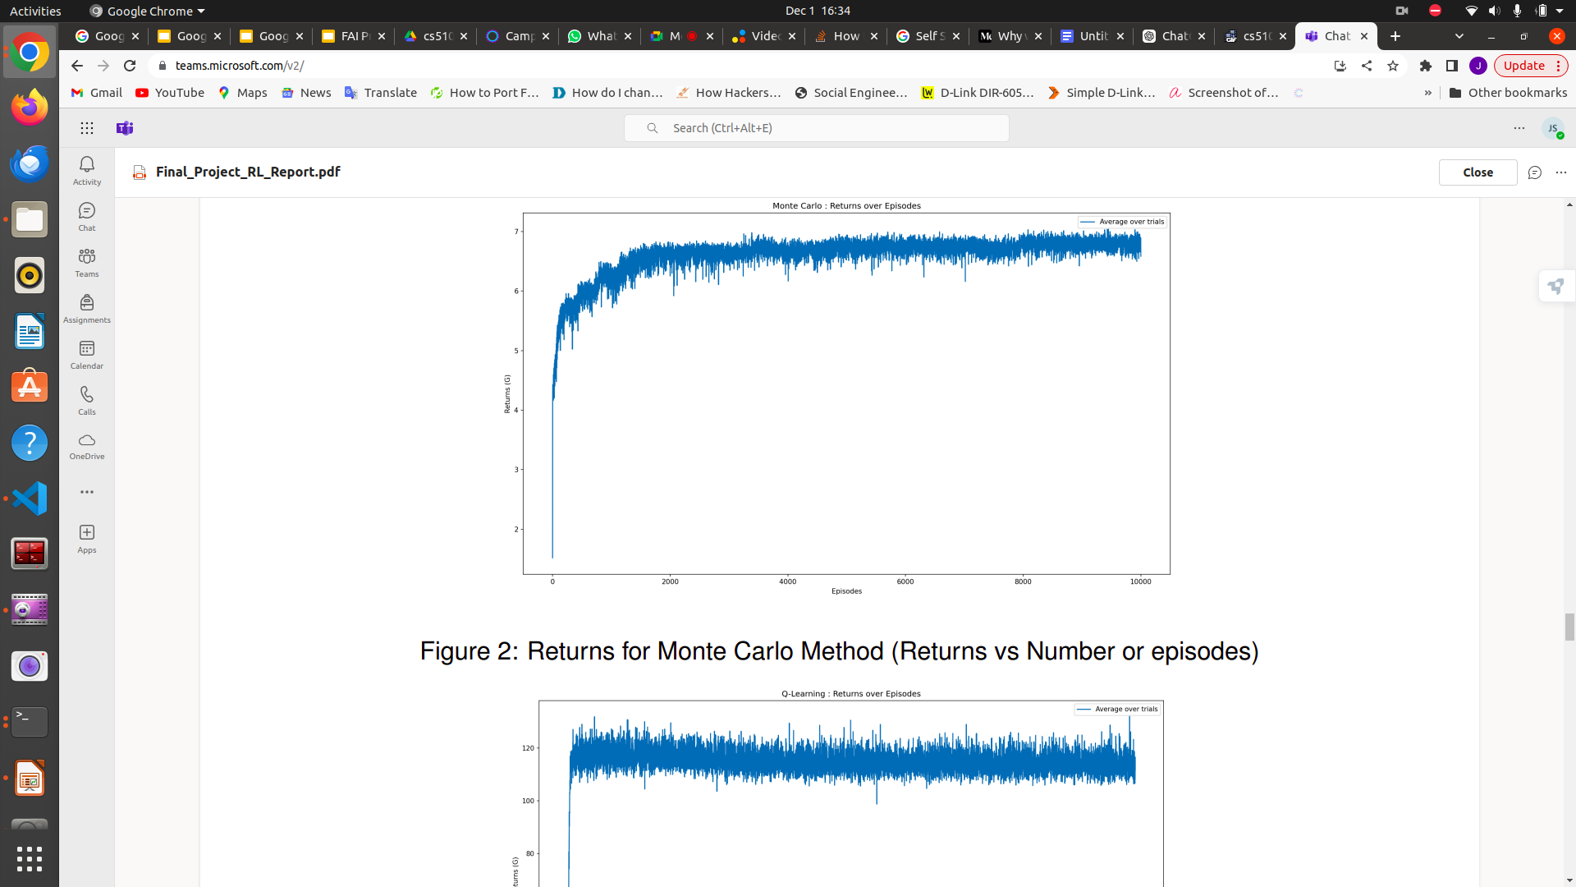
Rewards vs Episodes Visualizations
PPO
DQN

Slide 11
Comparison and Conclusion
Algorithm | Use Case | Pros | Cons | Train | Test
PPO | Control Based Tasks Robotic Arms (Contin. ActionSp) | Stable, efficient, balanced | Compute-heavy, Needs large samples | Stable learning | Good for generalization
DQN | Discrete ActionSp. Atari Games Static environments | Efficient for discrete tasks | Poor in dynamic settings, Easy Compute | Can be unstable | Good in similar environments
A* | Static environments, Optimal paths | Guaranteed shortest path | Ineffective in dynamic settings | N/A | Optimal in static environments
Notes:
The major drawback of this automation would likely impact grocery store owners, as people often tend to buy more than they initially planned. For example, if someone intends to purchase six items, they might end up wandering through the store aisles with a cart and discover additional products they hadn’t planned on buying but develop a craving for. As a result, they purchase more than they initially intended, which benefits the grocery store owner. However, with the implementation of this automation, such spontaneous purchases are eliminated. This raises the question: would grocery store owners ever be in favor of such automation?

Slide 12

THANK YOU

